Slide 1
FUNCTIONS & STORAGE CLASSES
Dr.V.Arulkumar
SCOPE

Slide 2
FUNCTIONS – AN INTRODUCTION
A function is a block of code that performs a specific task.
A function take input/s, do some specific computation and
produces output.
All C programs contain at least one function, called main() where execution starts.

Slide 3
TYPES OF FUNCTIONS
There are two types of function in C programming:
Standard library functions
User-defined functions
Notes:
C language has two types of functions namely standard library functions and user defined functions

Slide 4
TYPES OF FUNCTIONS (Cont…)
Standard Library Functions:
The standard library functions are built-in functions in C programming.
These functions are defined in header files.
For example,
1. sqrt() - Calculates the square root of a number.
The function is defined in the math.h header file.
2. strlen() – Gives the length of the string.
The function is defined in the string.h header file.
3. printf() ,scanf() – Performs input and output functions.
The function is defined in the stdio.h header file.
Notes:
Standard Library Functions are basically the inbuilt functions in the C compiler that makes things easy for the programmer.
As we have already discussed, every C program has at least one function, that is, the main() function. The main() function is also a standard library function in C since it is inbuilt and conveys a specific meaning to the C compiler. Standard library functions allow the programmer to use the pre-existing codes available in the C compiler without the need for the user to define his own code

Slide 5
TYPES OF FUNCTIONS (Cont…)
User-defined function
User can also create functions as per the program requirement to solve the specific task. Such functions created by the user are known as user-defined functions.
Notes:
A User-defined functions on the other hand, are those functions which are defined by the user at the time of writing program. These functions are made for code reusability and for saving time and space.

Slide 6
ADVANTAGES OF FUNCTIONS
Improve Modularity
Large program can be divided into multiple small modules.
This allows program will be easier to understand, maintain and
debug.
2. Code Reusability
Function can be reused in any program rather than writing the
same code from scratch.

Slide 7
DEFINING A FUNCTION
Syntax:
Return_type Function_name( parameter list)
{
Body of the function
}
Return type : Data type of the value that is returned. Return type can be of any data type such as int, double, char, void, short etc.
Function name: Meaningful name which describes the task that the function performs.
Arguments or Parameters: Argument are the variables names along with their data types. These arguments are kind of inputs for the function.
To use a function, that function is called using with its name and arguments.
Notes:
The general form of a function definition in C programming language is as follows −
Return Type − A function may return a value. The return_type is the data type of the value the function returns. Some functions perform the desired operations without returning a value. In this case, the return_type is the keyword void.
Function Name − This is the actual name of the function. The function name and the parameter list together constitute the function signature.
Parameters − A parameter is like a placeholder. When a function is invoked, you pass a value to the parameter. This value is referred to as actual parameter or argument. The parameter list refers to the type, order, and number of the parameters of a function. Parameters are optional; that is, a function may contain no parameters.
Function Body − The function body contains a collection of statements that define what the function does.

Slide 8
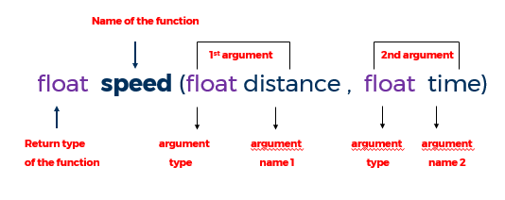
DEFINING A FUNCTION - Example

Slide 9
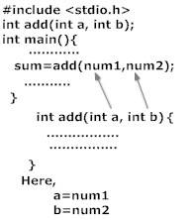
HOW TO USE USER DEFINED FUNCTION ?
To use a C user defined function,
the following steps are to be done:
Function declaration/Prototype:
This informs compiler about the
function name, function parameters
and return value’s data type.
2. Function call :
This calls the actual function.
3.Function definition :
This contains all the statements to be
executed.
Function Declaration /Prototype
Function call
Function Definition

Slide 10
FUNCTION DECLARATION / PROTOTYPE :
A function prototype is simply the declaration of a function that specifies function's name, parameters and return type.
It is written prior to the function's actual definition
A function prototype gives information to the compiler that the function may later be used in the program.
Syntax of function prototype
returnType functionName (type1 argument1, type2 argument2,...);
Notes:
A function prototype is simply the declaration of a function that specifies function's name, parameters and return type. It doesn't contain function body. A function prototype gives information to the compiler that the function may later be used in the program. Here we will see why we should use function prototype in C. The function prototypes are used to tell the compiler about the number of arguments and about the required datatypes of a function parameter, it also tells about the return type of the function. By this information, the compiler cross-checks the function signatures before calling it. If the function prototypes are not mentioned, then the program may be compiled with some warnings, and sometimes generate some strange output.

Slide 11
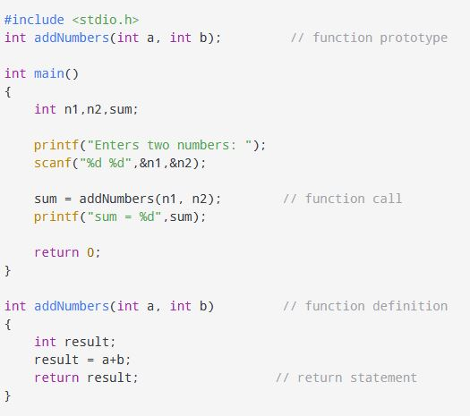
EXAMPLE

Slide 12
FUNCTION DECLARATION/PROTOTYPE (Cont…)
Example:
int addNumbers (int a, int b);
This the function prototype which provides the following
information to the compiler:
name of the function is addNumbers()
return type of the function is int
two arguments of type int are passed to the function
NOTE : The function prototype is not needed if the user-defined function is
defined before the main() function.

Slide 13
FUNCTION DECLARATION/PROTOTYPE (Cont…)
Example:
int addNumbers (int a, int b);
This the function prototype which provides the following
information to the compiler:
name of the function is addNumbers()
return type of the function is int
two arguments of type int are passed to the function
NOTE : The function prototype is not needed if the user-defined function is
defined before the main() function.

Slide 14
FUNCTION DECLARATION/PROTOTYPE (Cont…)
EXAMPLES :
float area_rectangle(int a, int b);
int diff(int a, int b, float c);
int equal(char a, char b) ;
int sum(int *a, int b);
int diff(int a[], int b);
int equal(float *a, char b);
Notes:
Here are a few examples for function declaration.

Slide 15
FUNCTION CALL
Control of the program is transferred to the user-defined
function by calling it.
Syntax of function call
functionName (argument1, argument2, ...);
Example 1:
addNumbers(n1, n2);
n1 and n2 are the inputs/arguments to the function.
Notes:
While creating a C function, you give a definition of what the function has to do. To use a function, you will have to call that function to perform the defined task.
When a program calls a function, the program control is transferred to the called function. A called function performs a defined task and when its return statement is executed or when its function-ending closing brace is reached, it returns the program control back to the main program.
To call a function, you simply need to pass the required parameters along with the function name, and if the function returns a value, then you can store the returned value.

Slide 16
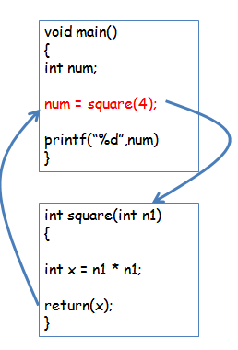
FUNCTION CALL ( Cont…)
EXAMPLE 2:
Function that calls another function is known as “calling function”
Function that is being called is known as “called function”
In example :
Calling function : main()
Called function : int square(int n1)
Notes:
AN example to calculate the square of a given number is given . It can be seen that main() is the calling function and square() is the called function

Slide 17
FUNCTION DEFINITION
Function definition contains the block of code to perform a specific task.
When a function is called, the control of the program is transferred to the function definition. The compiler starts executing the codes inside the body of the function.
Notes:
Function definition – This contains all the statements to be executed.

Slide 18
FUNCTION DEFINITION (Cont…)
Syntax:
return-value-type function-name ( parameter-list )
{
declarations and statements;
}
Function-name: any valid identifier
Return-value-type: data type of the result (default int)
Parameter-list: comma separated list, declares parameters
A type must be listed explicitly for each parameter unless, the parameter is of type int

Slide 19
FUNCTION DEFINITION (Cont…)
Example 1:
int addNumbers (int a, int b) // function definition
{
int result; // local variable declaration
result = a+b;
return result; // return statement
}
Notes:
In the example, addNumbers is a function with 2 arguments a and b which are of type int . The functions adds a and b and stores the value in the result varible which is then returned to the calling function using the return statement

Slide 20
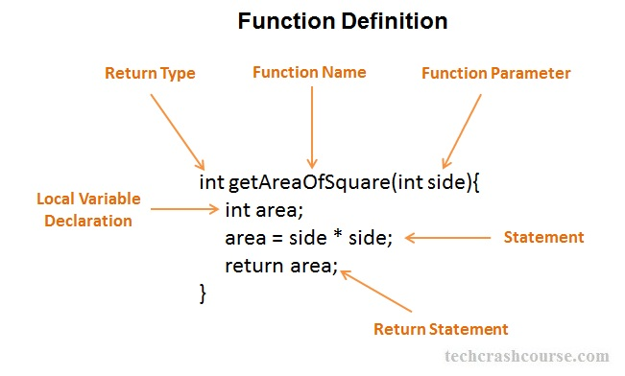
FUNCTION DEFINITION (Cont…)
EXAMPLE 2 :
Notes:
Here is the next example of function definition to calculate the area of a square. The function takes an interger value side as an argument and calculates the area of the square and returns the result which is also of type integer

Slide 21
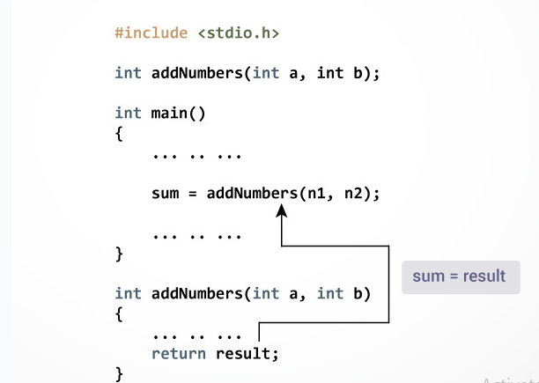
FUNCTION DEFINITION (Cont…)
EXAMPLE 1:
return Statement:
The return statement terminates the execution of a function and returns a value to the calling function.
The program control is transferred to the calling function after the return statement.
Syntax of return statement
return (expression);

Slide 22
FUNCTION DEFINITION return STATEMENT (Cont…)
EXAMPLES :
return 5; // returns a value
return x; // returns a variable
return a+b; // returns a value after doing addition
return &p; // returns an address stored in p
return *p; // returns a value pointed by p

Slide 23
FUNCTION DEFINITION return STATEMENT (Cont…)
If There is No return ?
Control is passed back to the calling environment when the closing brace of the body is encountered.
Known as “falling of the end.”

Slide 24
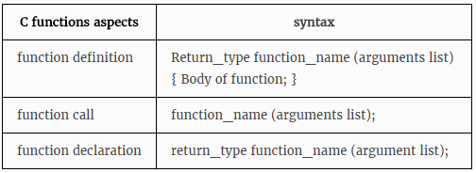
USER DEFINED FUNCTION – A RECAP
Notes:
Let us summarize the important aspects of c Functions - function definition, function call and function declaration along with their syntx

Slide 25
PROGRAM EXAMPLE 1 Find the square of a number
#include<stdio.h>
float square(float);
void main()
{
float m, n ;
printf ("\nEnter some number for finding square \n");
scanf ( "%f", &m ) ;
n = square(m) ;
printf("\nSquare of the given number %f is %f",m,n);
}
float square(float x)
{
float p;
p=x*x;
return(p);
}
OUTPUT :
Enter some number for finding square
3
Square of the given number 3.00000 is 9.00000
Notes:
Let us see an example to find the square of the given number using functions.

Slide 26
PROGRAM EXAMPLE 2: Function to Calculate the Minimum of 2 Values
#include <stdio.h>
int min(int a, int b);
int main(void)
{
int j, k, m;
printf("\nInput two integers: ");
scanf("%d%d", &j, &k);
m = min(j, k);
printf("\nOf the two values %d and %d, the minimum is %d.\n\n", j, k, m);
return 0;
}
int min(int a, int b)
{
if (a < b)
return a;
else
return b;
}
OUTPUT :
Input two integers : 5 7
Of the two values 5 and 7 ,the minimum is 5

Slide 27
PRACTICE EXERCISE
1. Write a C program for calculator application using
functions.
2. Write a C program to find all prime numbers between
given interval using functions.

Slide 28
ACTUAL VS FORMAL PARAMETERS
Actual Parameters are written within the parenthesis at the time of function call in calling statement
Formal Parameters are written within the parenthesis at the time of function definition. Or in the function header.
Notes:
Arguments which are mentioned in the function call is known as the actual argument. Arguments which are mentioned in the definition of the function is called formal arguments. Formal arguments are very similar to local variables inside the function.

Slide 29
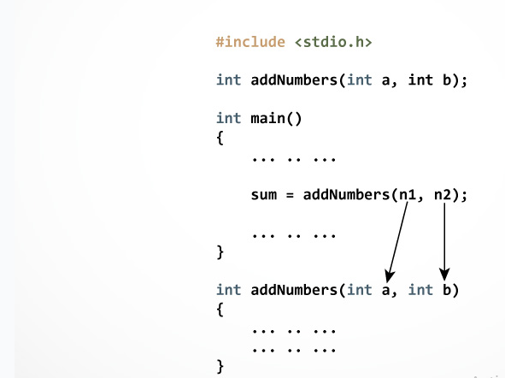
ACTUAL VS FORMAL PARAMETERS
In the example, two variables n1 and n2 are passed during the function call. These arguments are called actual parameters of the function.
The parameters a and b accepts the passed arguments in the function definition. These arguments are called formal parameters of the function.
Notes:
Let us see an example for actual and formal parameters
Order, number, and type of the actual arguments in the function call must match with formal arguments of the function.
If there is type mismatch between actual and formal arguments then the compiler will try to convert the type of actual arguments to formal arguments

Slide 30
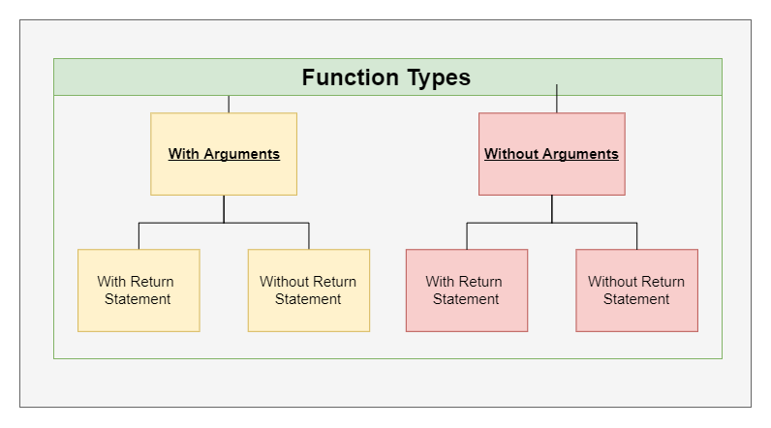
FUNCTION TYPES
Notes:
For better understanding of arguments and return in functions, user-defined functions can be categorised into 4 types:
Function with no argument and no Return value
Function with no argument and with a Return value
Function with argument and No Return value
Function with argument and Return value

Slide 31
FUNCTION TYPES (Cont…) EXAMPLE : SUM OF TWO NUMBERS
With arguments and with return values
#include <stdio.h>
int add(int,int); // Function Declaration
main()
{
int a=10,b=20,sum;
printf(“Addition”);
sum=add(a,b); // Function Call
printf(“sum = %d”,sum);
}
int add(int x, int y) // Function Definition
{
return x+y;
}
Output :
Addition
Sum=30

Slide 32
FUNCTION TYPES (Cont…) EXAMPLE : SUM OF TWO NUMBERS
2. With arguments and without return values
#include <stdio.h>
void add(int,int); // Function Declaration
main()
{ int a=10,b=20;
printf(“Addition”);
add(a,b); // Function Call
}
void add(int x, int y) // Function Definition
{
int sum;
sum= x + y;
printf(“sum = %d”,sum);
}
Output :
Addition
Sum=30

Slide 33
FUNCTION TYPES (Cont…) EXAMPLE : SUM OF TWO NUMBERS
3. Without arguments and with return values
#include <stdio.h>
int add(void); // Function Declaration
main()
{ int sum;
printf(“Addition”);
sum=add(); // Function Call
printf(“sum = %d”,sum);
}
int add(void) // Function Definition
{
int x=10,y=20;
return x+y;
}
Output :
Addition
Sum=30

Slide 34
FUNCTION TYPES (Cont…) EXAMPLE : SUM OF TWO NUMBERS
4. Without arguments and without return values
void add(void); // Function Declaration
main()
{
add(); // Function Call
}
void add() // Function Definition
{
int a=10,b=20,sum;
sum = a+b;
printf(“Addition”);
printf(“sum = %d”,sum);
}
Output :
Addition
Sum=30

Slide 35
CALL BY VALUE & CALL BY REFERENCE
There are two ways to pass value or data to function in
C language which is given below:
Call by value
Call by reference
Notes:
functions can be invoked in two ways: which is known as Call by Value and Call by Reference.

Slide 36
CALL BY REFERENCE VS CALL BY VALUE
Call by Reference | Call by Value
This method copies the address of arguments into function as arguments. | This method copies the original value into function as arguments.
Actual and formal arguments share the same address space | Actual and formal arguments are stored in the different address space
Notes:
Call by reference method copies the address of an argument into the formal parameter. In this method, the address is used to access the actual argument used in the function call. It means that changes made in the parameter alter the passing argument.
All the operation in the function are performed on the value stored at the address of the actual parameter, and the modified value will be stored at the same address.
Call by value method copies the value of an argument into the formal parameter of that function. Therefore, changes made to the parameter of the main function do not affect the argument.

Slide 37
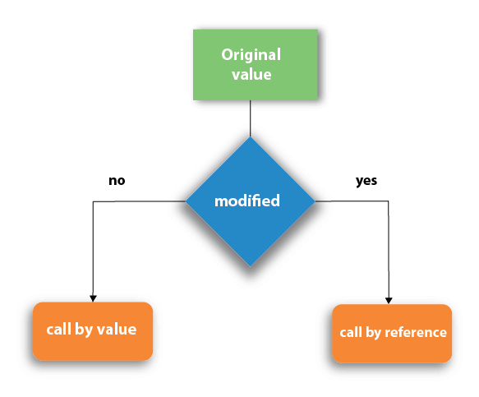
CALL BY REFERENCE VS CALL BY VALUE
Call by Reference | Call by Value
Both the actual and formal parameters refer to the same memory locations and so, any changes made inside the function are reflected in actual parameters of the calling function. | Values of actual parameters are copied to function’s formal parameters and the two types of parameters are stored in different memory locations. So, any changes made inside functions are not reflected in actual parameters of the calling function.

Slide 38
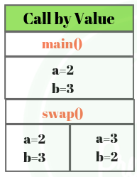
CALL BY VALUE - EXAMPLE
Call by Value
#include<stdio.h> #include<conio.h> void swap(int a, int b) { int temp; temp=a; a=b; b=temp; } void main() { int a=2, b=3; clrscr(); swap(a, b); // passing value to function printf("\nValue of a: %d",a); printf("\nValue of b: %d",b); getch(); }
Output:
Inside Function
Value of a: 3
Value of b: 2
Inside main
Value of a: 2
Value of b: 3
Notes:
Thus actual values of a and b remain unchanged even after swapping them. In call by value we cannot alter the values of actual variables through function calls.

Slide 39
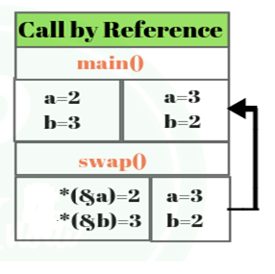
CALL BY REFERENCE - EXAMPLE
Call by reference
#include<stdio.h> void swap(int *a, int *b) { int temp; temp=*a; *a=*b; *b=temp; printf(“\n Inside Function”); printf("\nValue of a: %d",a); printf("\nValue of b: %d",b); } void main() { int a=2, b=3; swap(&a, &b); // passing value to function printf(“\n Inside main); printf("\nValue of a: %d",a); printf("\nValue of b: %d",b); }
Output:
Inside Function
Value of a: 3
Value of b: 2
Inside main
Value of a: 3
Value of b: 2
Notes:
In call by reference, original value is changed or modified because we pass reference (address). Here, address of the value is passed in the function, so actual and formal arguments shares the same address space. Hence, any value changed inside the function, is reflected inside as well as outside the function.
This method copy address of arguments into function as a arguments. Changes made to the parameter affect the argument. Because address is used to access the actual argument.

Slide 40
UNIT III : FUNCTIONS & STORAGE CLASSES
Week3 – Module 1 – Topic 3
Passing Arrays to Function

Slide 41
PASSING ARRAY TO A FUNCTION
To pass a list of elements as argument to any function in C
language, it is preferred to do so using an array.
Declaring Function with array as a parameter
1.Have an array as a parameter.
Single array element or one-dimensional array or multidimensional
array can be passed as an argument to a function.
2. Have a pointer in the parameter list, to hold the base address of
the array.

Slide 42
PASSING ARRAY TO A FUNCTION ( Cont …)
Returning an Array from a function
Pointer to the array holding the base address of the array to be returned.
SYNTAX EXAMPLE :
int* sample (int x[]) // Function Definition
{
…
…
…
return x ; // x is the base address of the array
}

Slide 43
PASSING ARRAY TO A FUNCTION (Cont …)
Passing a single array element to a function
Program Example :
#include<stdio.h>
void give_element (int a);
void main()
{
int myArray[] = { 2, 3, 4 };
give_element(myArray[2]); //Passing array element myArray[2] only.
}
void give_element(int a)
{ printf("%d", a); }
Output:
4

Slide 44
PASSING ARRAY TO A FUNCTION(Cont …)
Passing a one dimensional array to a function
EXAMPLE :
#include<stdio.h>
float findAverage(int marks[]);
int main()
{ float avg;
int marks[] = {99, 90, 96, 93, 95};
avg = findAverage(marks); // name of the array is passed as argument.
printf("Average marks = %f", avg);
return 0;
}
float findAverage(int marks[])
{ int i, sum = 0;
float avg;
for (i = 0; i <= 4; i++)
{ sum += marks[i]; }
avg = (sum / 5);
return avg;
}
Output:
94.6

Slide 45
PASSING ARRAY TO A FUNCTION (Cont…)
Passing a Two dimensional array to a function
EXAMPLE :
#include <stdio.h>
void print(int arr[3][3])
{
int i, j;
for (i = 0; i < 3; i++)
for (j = 0; j < 3; j++)
printf("%d ", arr[i][j]);
}
int main()
{
int arr[3][3] = {{1, 2, 3}, {4, 5, 6}, {7, 8, 9}};
print(arr);
return 0;
}
Output:
1 2 3 4 5 6 7 8 9

Slide 46
PASSING STRING TO A FUNCTION
A string is a sequence of characters enclosed with in double quotes terminated with a null character ‘\0’.
String is also termed as character array.

Slide 47
PASSING STRING TO A FUNCTION
EXAMPLE:
void printStr(char str[])
{
printf("String is : %s",str);
}
int main()
{
char str[] = “C Programming"; // declare and initialize string
printStr(str); // Passing string to the function
return 0;
}
OUTPUT:
C Programming

Slide 48
PROGRAM FOR PRACTICE
Write a C program to count total number of negative elements in an array using functions.
Write a C program to find transpose of a matrix using functions.
Write a C program to count total number of vowels and consonants in a string using functions.

Slide 49
RECURSIVE FUNCTION - RECURSION
A function that calls itself is known as a recursive
function. This technique is known as recursion.

Slide 50
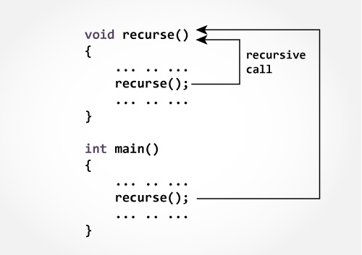
HOW DOES RECURSION WORKS?
Note :The recursion continues until some condition is met to prevent it.
To prevent infinite recursion, if...else statement (or similar approach) can be used where one branch makes the recursive call, and other doesn't.

Slide 51
PROGRAM EXAMPLE To find the factorial of a number n
#include<stdio.h>
long int fact(int n); // Function Declaration
int main()
{
int n;
printf("Enter a positive integer: ");
scanf("%d",&n);
printf("Factorial of %d = %ld", n, fact(n)); // Function Call
return 0;
}
long int fact(int n) // Function Definition
{
if (n ==1)
return 1;
else
return n*fact(n-1);
}
Output:
Enter a positive integer : 3
Factorial of 3 = 6

Slide 52
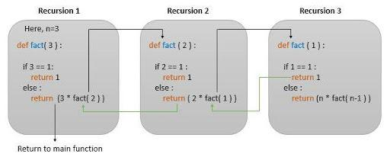
RECURSION (Cont…) HOW DOES THE PROGRAM WORKS ?

Slide 53
RECURSION EXAMPLE 2 Reverse a sentence using recursion
#include <stdio.h>
void reverseSentence();
int main()
{
printf("Enter a sentence: ");
reverseSentence();
return 0;
}
void reverseSentence()
{ char c;
scanf("%c", &c);
if (c != '\n')
{
reverseSentence();
printf("%c", c);
}
}
Output:
Enter a sentence: margorp emosewa awesome program

Slide 54
PROGRAM FOR PRACTICE
Write a C program to find sum of digits of a given
number using recursion.
2. Write a C program to generate nth Fibonacci term using recursion.

